Slide 1
PHY 211: ELEMENTARY MODERN PHYSICS 3units
(Relativistic Velocity addition)
DR OKAFOR P.N.
DEPARTMENT OF PHYSICS
COLLEGE OF SCIENCE AND TECHNOLOGY
CONVENANT UNIVERSITY
2025/26

Slide 2
OBJECTIVES
The students are able to explain velocity addition using the Lorentz transformation
Students are able to write down inverse Lorentz transformation and calculate relativistic velocity.

Slide 3
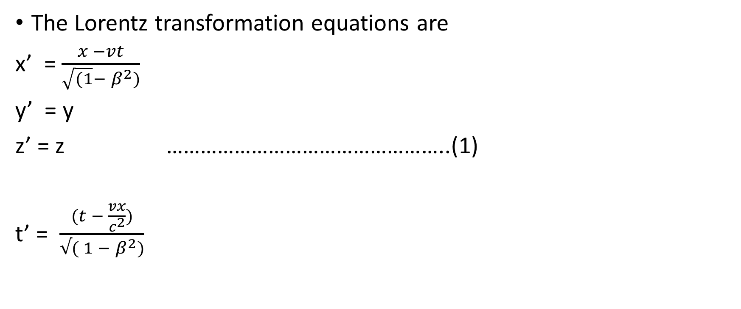
Relativistic Velocity Addition
The Lorentz transformation equations are
x’ = $\frac{x −vt}{\sqrt{(1}− β^{2})}$
y’ = y
z’ = z …………………………………………..(1)
t’ = $\frac{(t − \frac{vx}{c^{2}})}{√( 1 − β^{2})}$

Slide 4
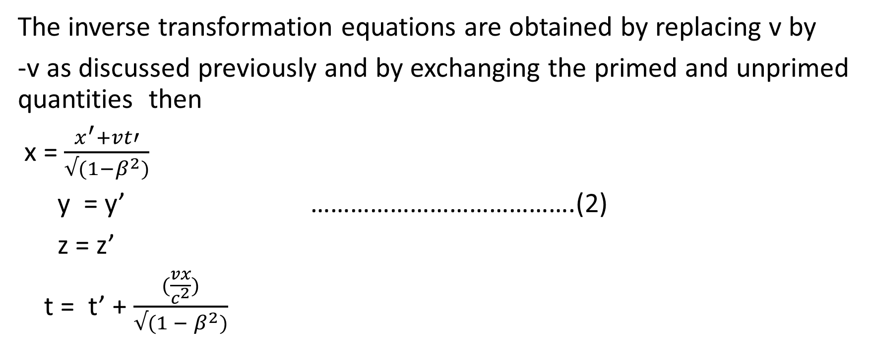
Velocity addition
The inverse transformation equations are obtained by replacing v by
-v as discussed previously and by exchanging the primed and unprimed quantities then
x = $\frac{x^{′}+vt′}{√(1−β^{2})}$
y = y’ ………………………………….(2)
z = z’
t = t’ + $\frac{(\frac{vx}{c^{2}})}{√(1 − β^{2})}$

Slide 5
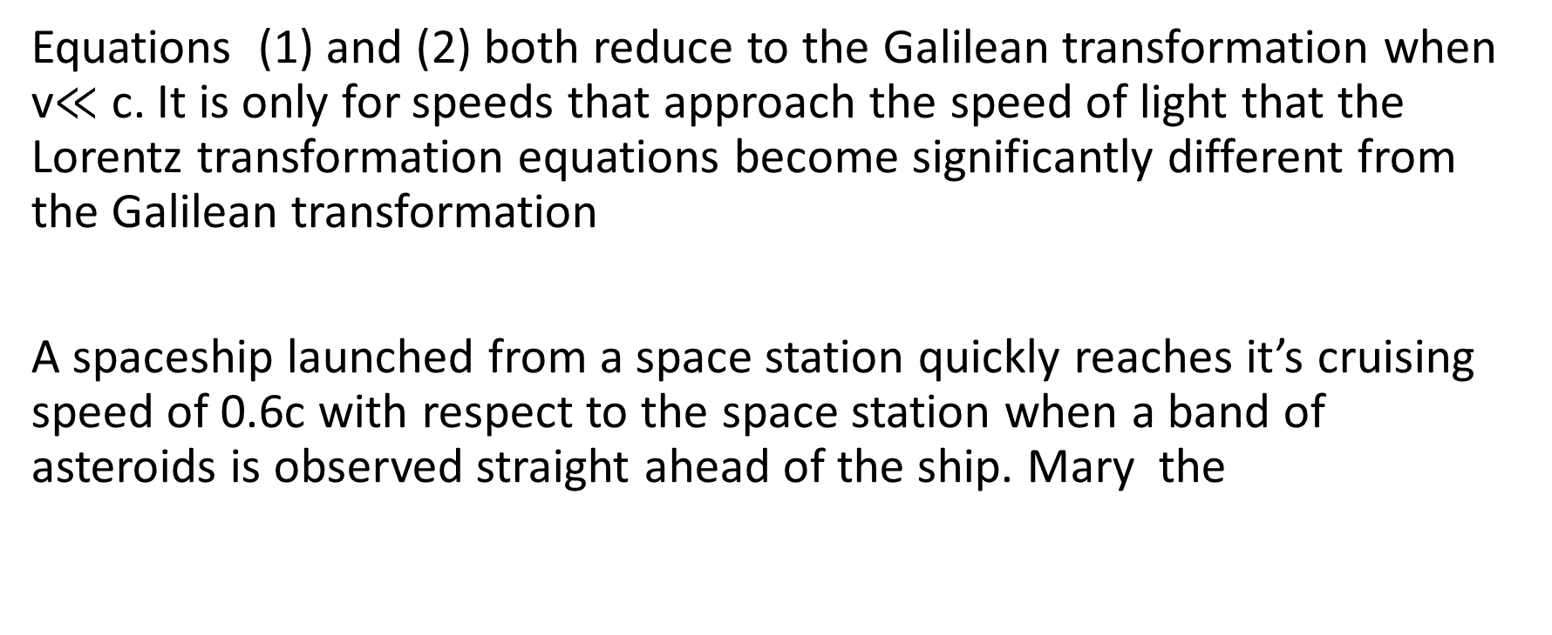
Relativistic velocity addition
Equations (1) and (2) both reduce to the Galilean transformation when v$≪$ c. It is only for speeds that approach the speed of light that the Lorentz transformation equations become significantly different from the Galilean transformation
A spaceship launched from a space station quickly reaches it’s cruising speed of 0.6c with respect to the space station when a band of asteroids is observed straight ahead of the ship. Mary the

Slide 6
Velocity addition
commander reacts quickly and orders her crew to blast away the asteroids with the ship’s proton gun to avoid a catastrophic collision.
Frank, the admiral on the space station listens with apprehension to the communication because he fears the asteroids may eventually destroy his space station as well.
Will the high energy protons of 0.99c be able to successfully blast away
the asteroids and save both the space ship and the space station?

Slide 7
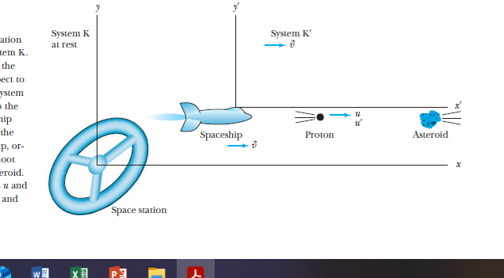
Velocity Addition

Slide 8
Velocity Addition
If 0.99c is the speed of the protons with respect to the space ship, what speed will Frank measure for the protons?
We will use the letter u to denote velocity of objects as measured in various co ordinate systems . In this case, Frank (in the fixed, stationary system K on the space station) will measure the velocity of the protons to be u. Mary the commander of the space ship(in the moving system K’) will measure u’ = 0.99c
We reserve the letter v to express the velocity of the coordinate systems with respect to each other.

Slide 9
Velocity addition
The velocty of the space ship with respect to the space station is v = 0,60c. Newtonian mechanics teaches us that to find the velocity of the protons with respect to the space station, we simply add the velocity of the spaceship with respect to the space station (o.60c) to the velocity of the protons with respect to the space ship (0.99c) to determine the result u = v + u’ = 0.60c + 0.99c = 1.59c.
However, this result is not in agreement with the result of the Lorentz transformation.

Slide 10
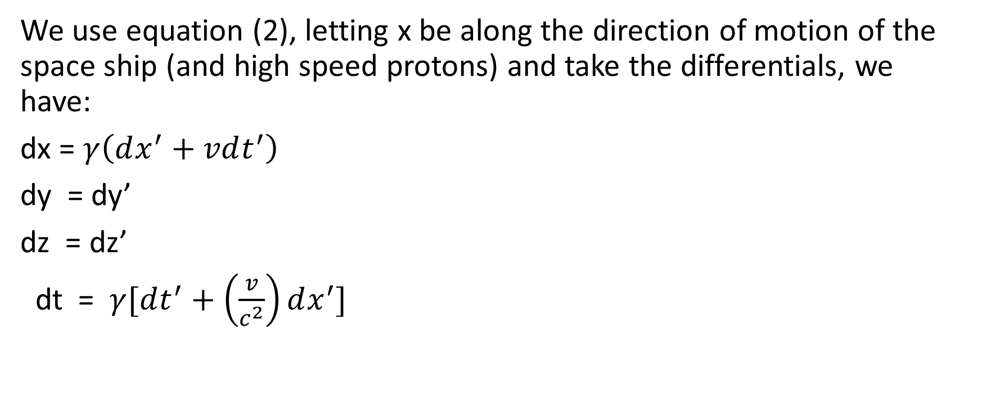
Relativistic velocity addition
We use equation (2), letting x be along the direction of motion of the space ship (and high speed protons) and take the differentials, we have:
dx = $γ\left(dx^{′}+vdt^{′}\right)$
dy = dy’
dz = dz’
dt = $γ[dt^{′}+\left(\frac{v}{c^{2}}\right)dx^{′}]$

Slide 11
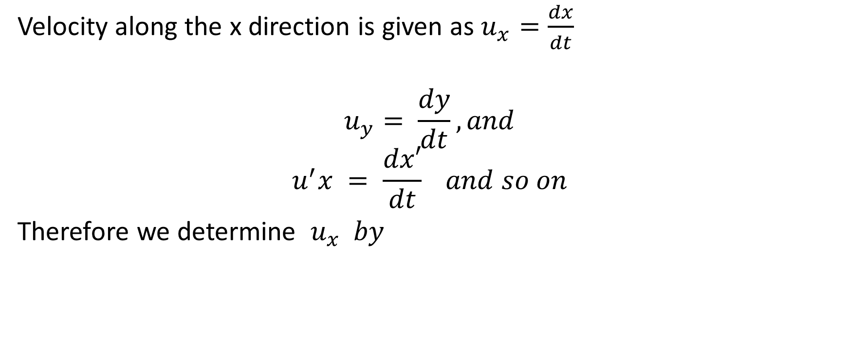
Relativistic velocity addition
Velocity along the x direction is given as $u_{x}=\frac{dx}{dt}$
$$u_{y}= \frac{dy}{dt}, and$$
$$u^{′}x = \frac{dx′}{dt} and so on$$
Therefore we determine $u_{x} by$

Slide 12
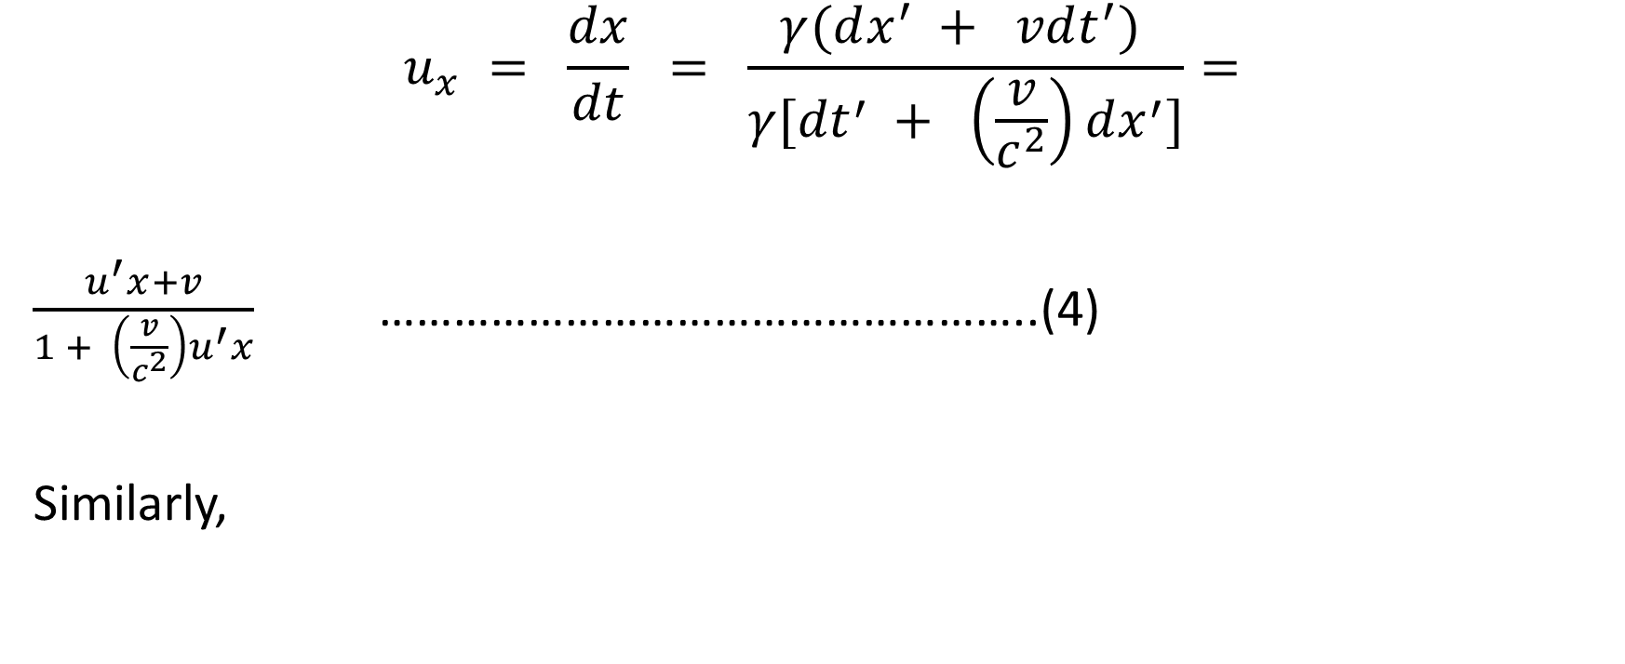
Relativistic velocity addition
$$u_{x} = \frac{dx}{dt} = \frac{γ(dx^{′} + vdt^{′}) }{γ[{dt}^{′} + \left(\frac{v}{c^{2}}\right)dx^{′}]}=$$
$\frac{u^{′}x+v}{1 + \left(\frac{v}{c^{2}}\right)u^{′}x}$ ……………………………………………..(4)
Similarly,

Slide 13
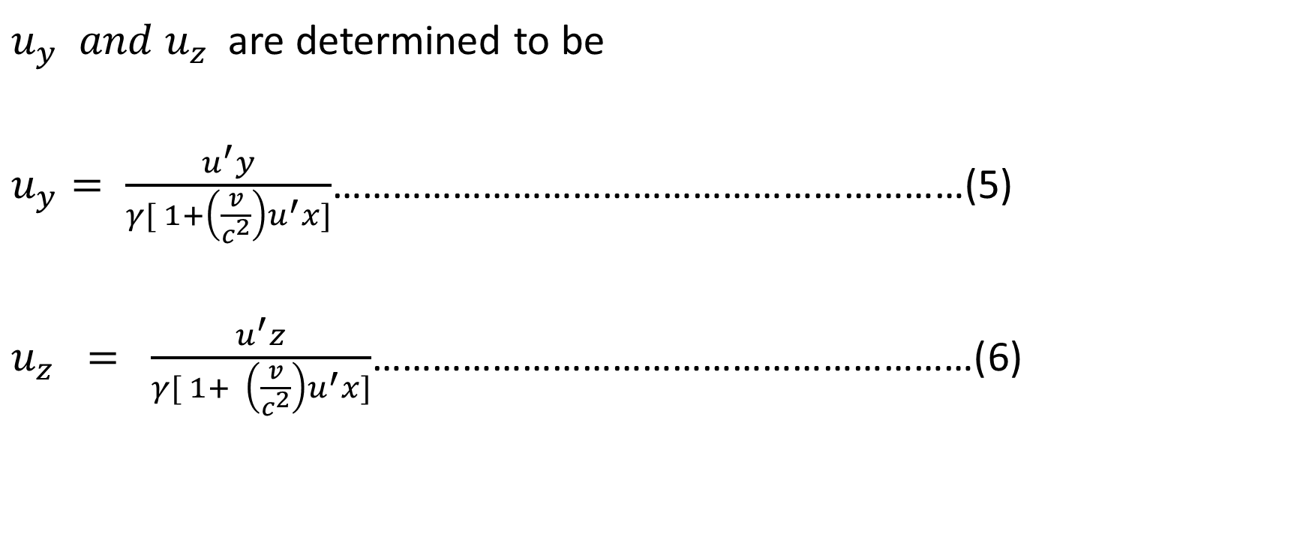
Relativistic velocity addition
$u_{y} and u_{z}$are determined to be
$u_{y}= \frac{u^{′}y}{γ[ 1+\left(\frac{v}{c^{2}}\right)u^{′}x]}$………………………………………………………(5)
$u_{z} = \frac{u^{′}z}{γ[ 1+ \left(\frac{v}{c^{2}}\right)u^{′}x]}$……………………………………………………(6)

Slide 14
Relativistic velocity addition
Equations 4 to 6 are referred to as the Lorentz velocity transformation equations.
We notice that although the relative motion of the systems K and K’ is only along the x direction the velocities along the y and z directions
are affected as well. This contrasts with the Lorentz transformation equations, where y = y’ and z =z’
However , the difference in velocities is simply ascribed to the

Slide 15
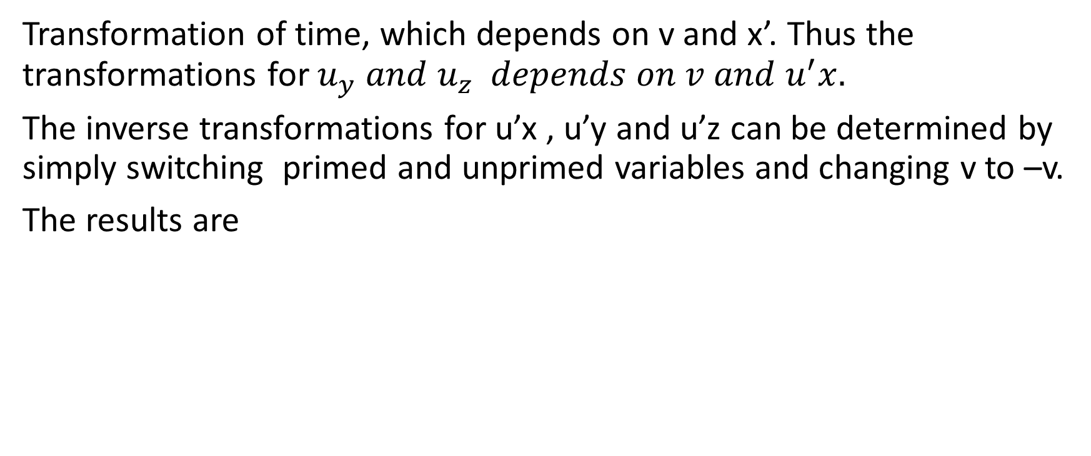
Relativistic velocity addition
Transformation of time, which depends on v and x’. Thus the transformations for $u_{y} and u_{z} depends on v and u^{′}x.$
The inverse transformations for u’x , u’y and u’z can be determined by simply switching primed and unprimed variables and changing v to –v.
The results are

Slide 16
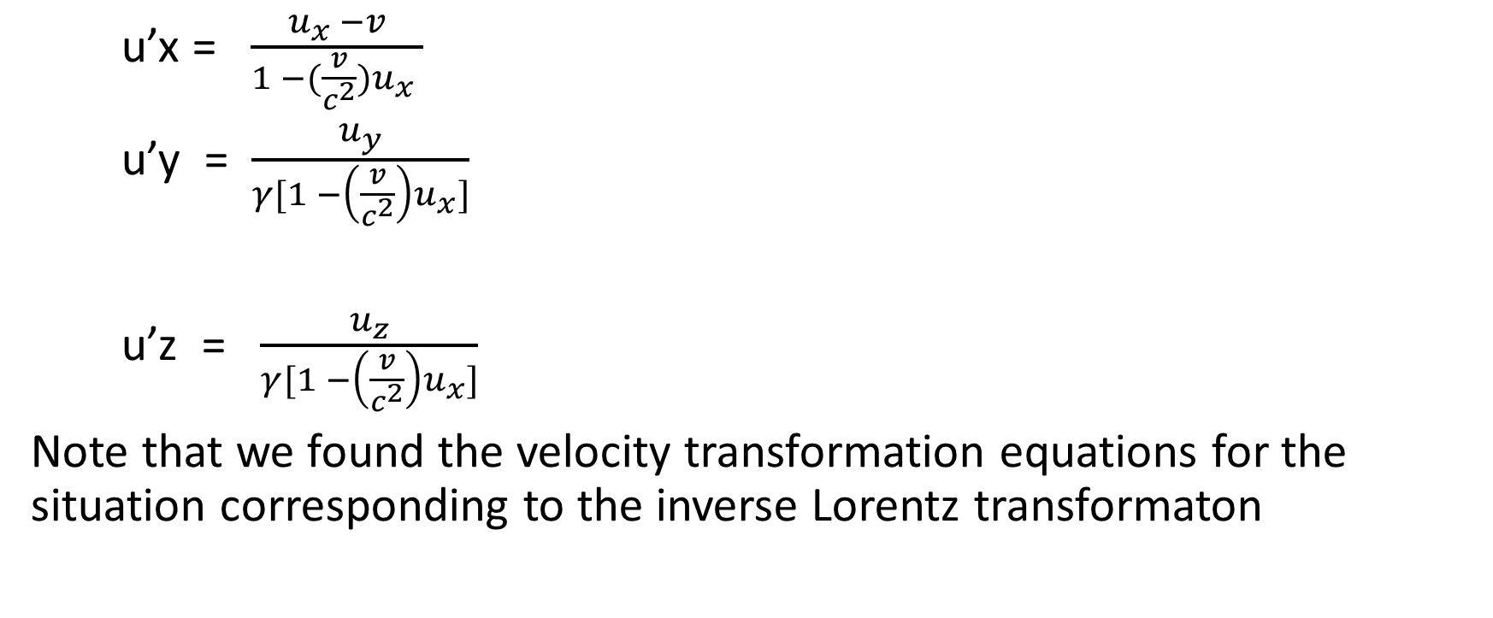
Relativistic velocity addition
u’x = $\frac{u_{x} −v}{1 −(\frac{v}{c^{2}})u_{x} }$
u’y = $\frac{u_{y}}{γ[1 −\left(\frac{v}{c^{2}}\right)u_{x}]}$
u’z = $\frac{u_{z}}{γ[1 −\left(\frac{v}{c^{2}}\right)u_{x}]}$
Note that we found the velocity transformation equations for the situation corresponding to the inverse Lorentz transformaton

Slide 17
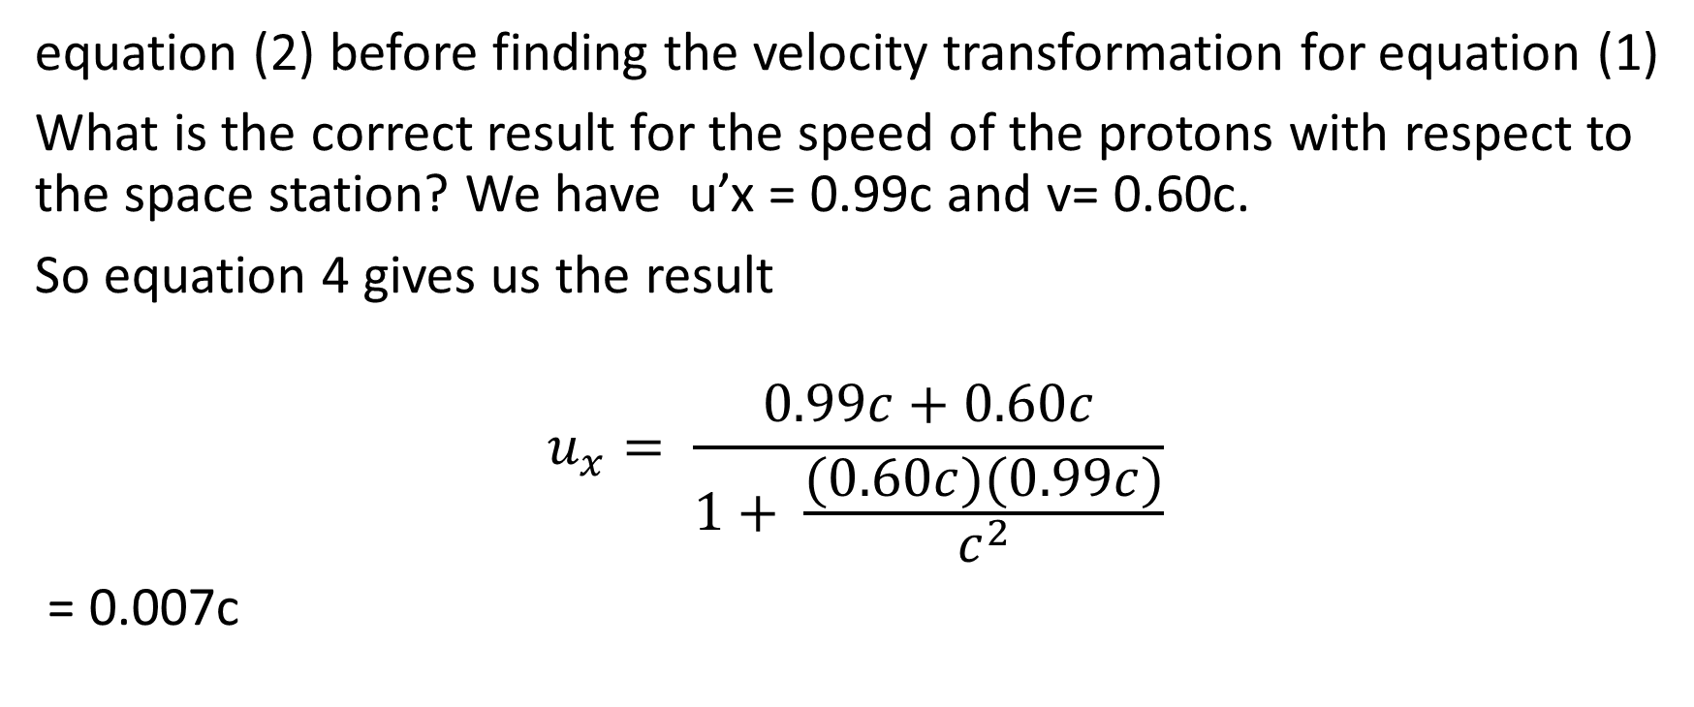
Relativistic velocity addition
equation (2) before finding the velocity transformation for equation (1)
What is the correct result for the speed of the protons with respect to the space station? We have u’x = 0.99c and v= 0.60c.
So equation 4 gives us the result
$$u_{x}= \frac{0.99c+0.60c}{1+ \frac{(0.60c)(0.99c)}{c^{2}}}$$
= 0.007c

Slide 18
Relativistic velocity addition
Where we have assumed we know the speed to 3 significant figures
The result is a speed only slightly less than c. The Lorentz transformation does not allow a material object to have speed greater than c. Only massless particles such as light can have speed c.
If the crew members of the space ship spot the asteroids far enough in advance, their reaction times should allow them to shoot down the uncharacteristically swiftly moving asteroids and save both the space ship and the space station.

Slide 19
Review Questions
Write down the Lorentz transformation and it’s inverse
When does the Lorentz transformation reduce to the Galilean transformation?
Protons from a space ship are ejected with a velocity of 0.9c relative to the space ship. The velocity of the space ship relative to the space station is 0.5c. What is the velocity observed for the protons by somebody in the space station?

